Slide 1


Quantitative Data Structure Management and Visualization
Muhammad Akmal Farouqi
19/10/2024
www.ugm.ac.id
Locally Rooted, Globally Respected

Slide 2
Pengenalan R dan Rstudio

Slide 3
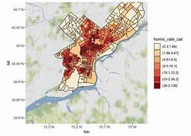
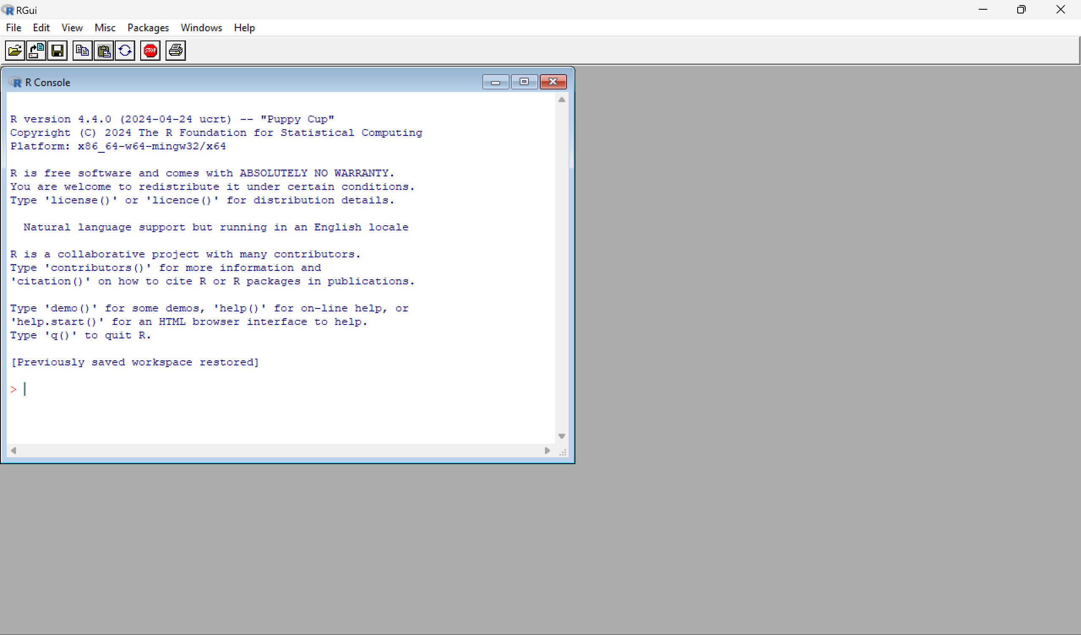
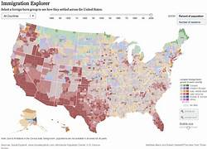
R and Rstudio
Definition:
Why R?
Rstudio
R is a programming language for statistical computing and data visualization. It has been adopted in many fields such as economics and geography.
Free, open-source, and large community
Suitable for data and statistical analysis
Used in almost every industry
Rstudio is an IDE for working with R programing language
Benefits of using Rstudio
R interface
Provides robust debugging tools
Includes built-in tools for creating interactive and visually appealing plots
Facilitates project organization, version control integration, and seamless package management
user-friendly interface for installing, updating, and managing packages

Slide 4
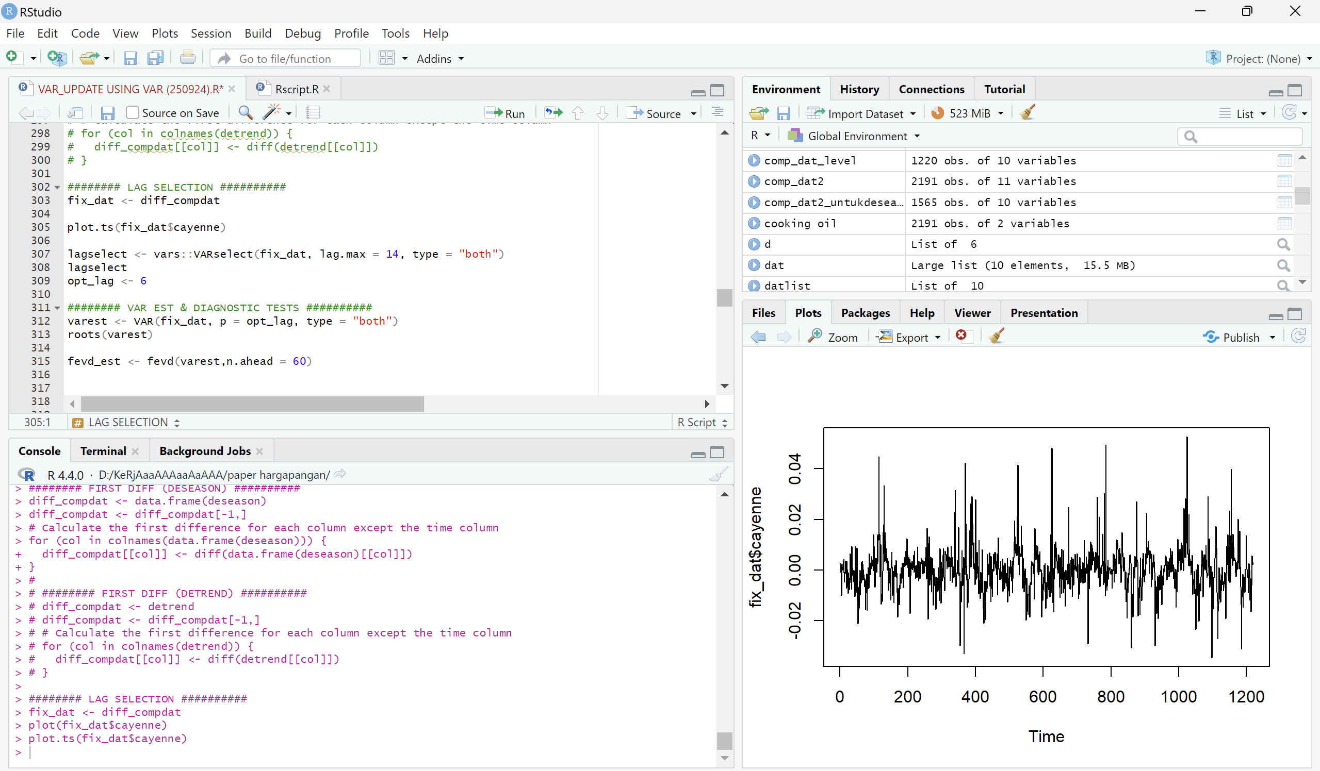
Rstudio Interface
serves as your canvas for composing and executing R code. Here, you can fashion R scripts, devise functions, and dynamically delve into data using R commands
Where your data stored in environment
History of your executed code
Plot window
Folders and packages
Help window
Console:
results of your executed code
Terminal:
provides access to the system shell directly from the RStudio IDE

Slide 5
Rstudio Interface
Your code results file will appear here
Run your code here (or click ctrl+enter)
type your code here
Your code’s result is presented here
Your plot is shown here

Slide 6


Package and library
R is similar to your gadget, you need to install “apps” that are suitable for your needs
In R we called it “package”
There are uncountable packages that exist (and are free) in R and each of them has different functions!
ggplot2 → data viz
tseries → time-series estimation
tidyverse → data wrangling
And many more….
only once at the beginning
All you need to do is:
install.packages(“package_name”)
library(package_name)
has to be executed every session

Slide 7
Tipe dan Jenis Data

Slide 8
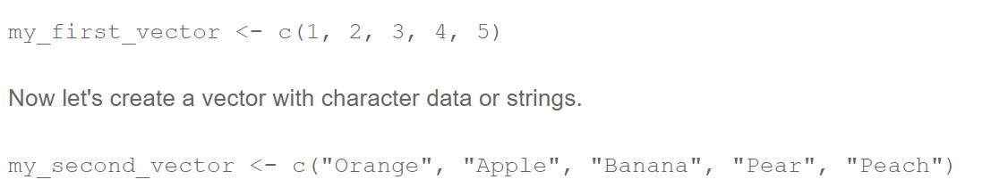
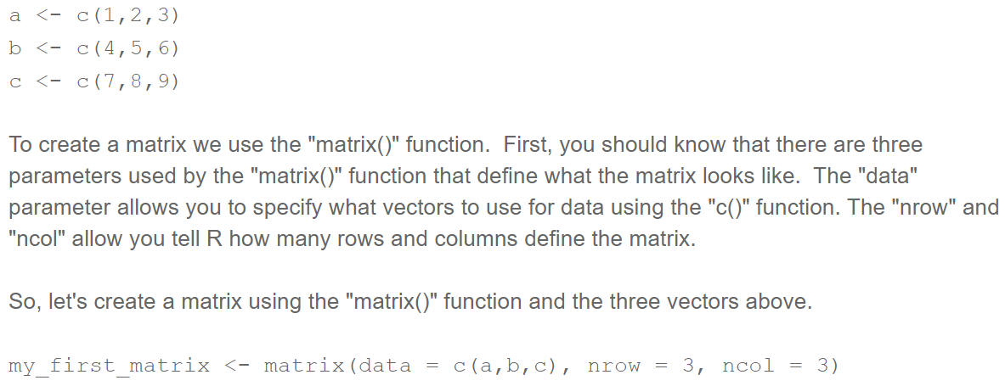
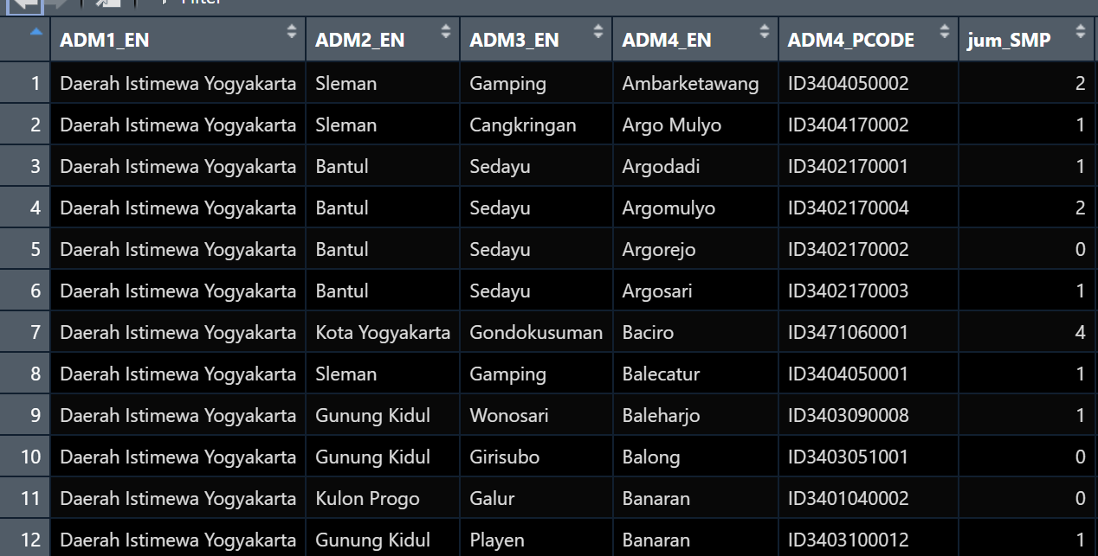
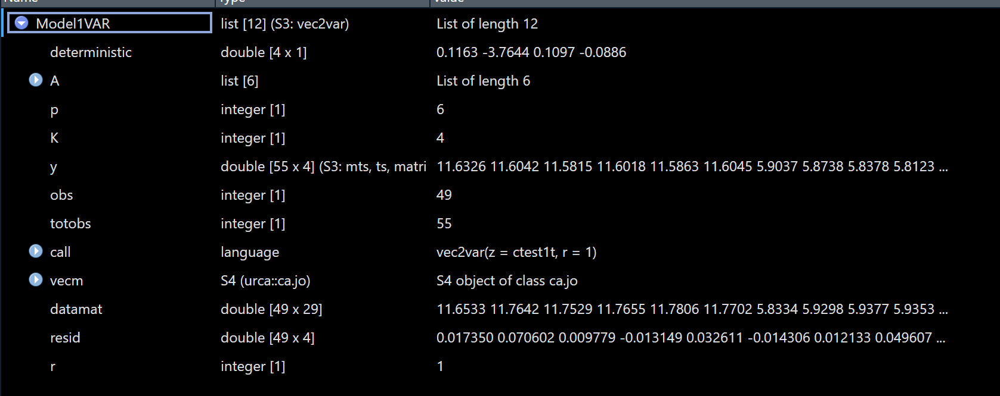
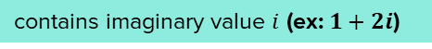
Tipe Data
Factor
Stored value as categorical variable
Numeric
Number (ex: 1,00; 4; 6,75)
Vector
Integer
Non-decimal number (ex: 1; 3; 5)
Matrix $n×1$ or $1×m$
Character
Storing text (“Hello World”)
Logical
Boolean (TRUE FALSE)
Matrix
Complex
contains imaginary value $i$ (ex: $1+2i$)
Date & POSIXct
Store data at date and time format
Data Frame
List
similar to excel sheet, designed to hold tabular data
generic object consisting of an ordered collection of objects. Lists are one-dimensional, heterogeneous data structures.

Slide 9
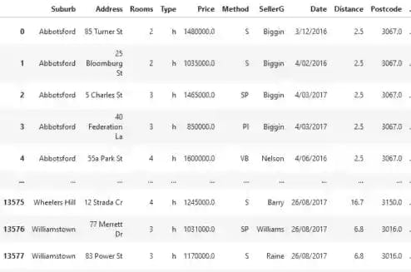
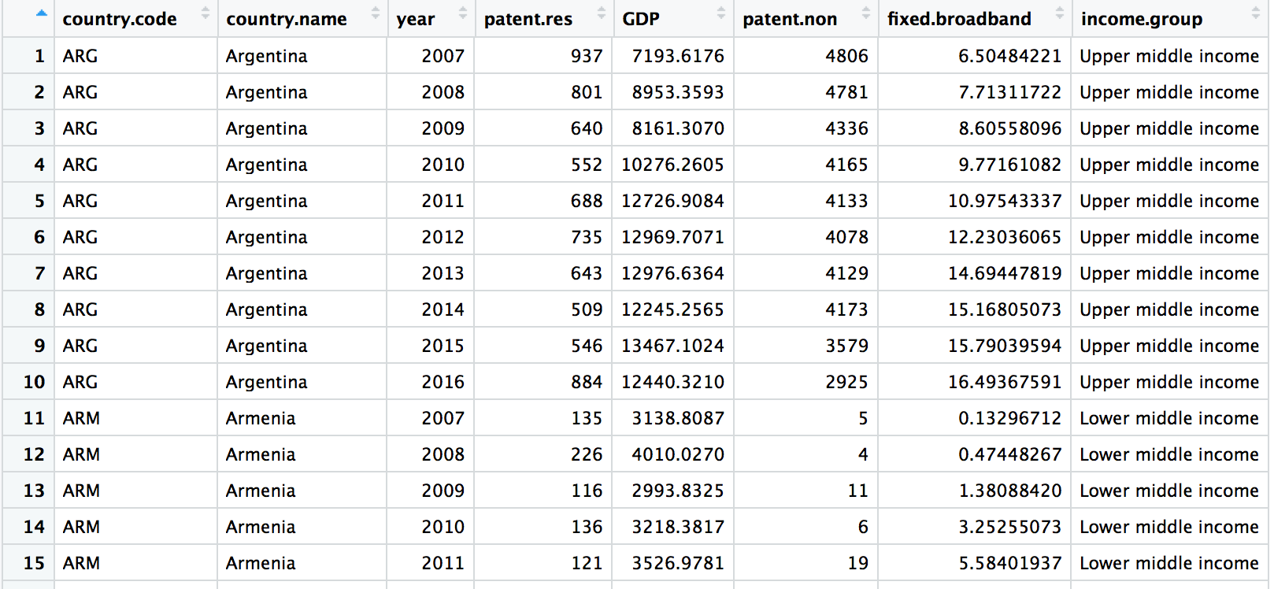
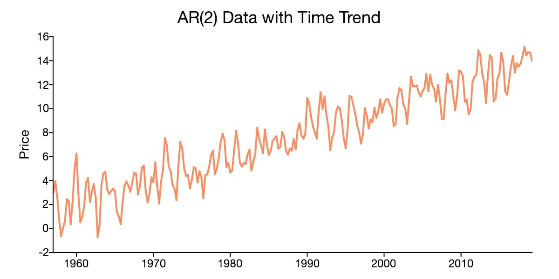
Jenis Data
Cross-sectional
Panel
Time series
Consists of multiple observations and each of them is observed more than 1 period. Sometimes called longitudinal data (Observations > Periods)
refers to data of one entity appearing consecutively for certain periods that usually has important components such as trend, seasonal, cyclical, and noise
refers to sample collected at a specific time period
Ex: Data PDRB Kabupaten 2019-2023
Ex: Data inflasi Indonesia 1968M1:2024M9
Ex: Susenas, survey kepuasan pelanggan

Slide 10
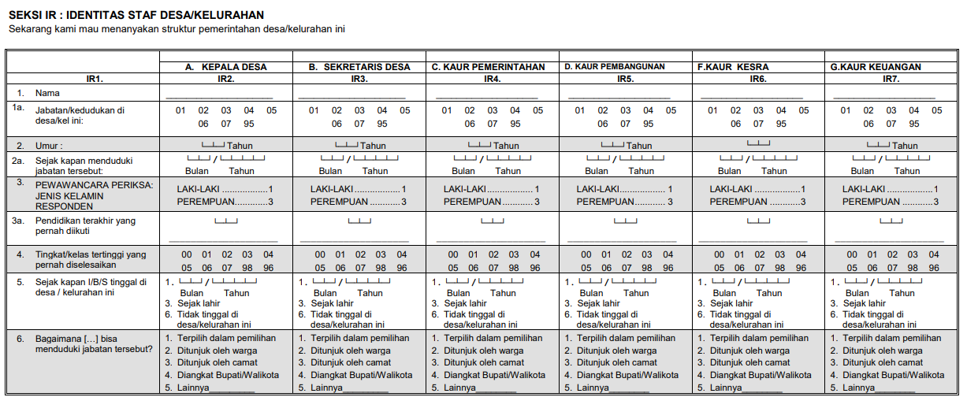
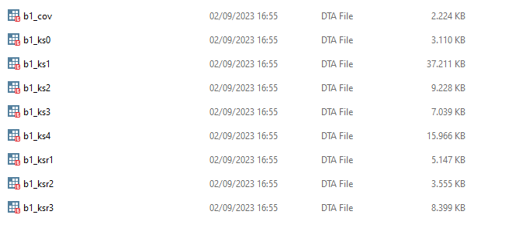
Data Management
Unfortunately, not all data are ready to estimate. It could be scattered, not in the correct format, need to be transformed, or even missing. Therefore, it is important to learn how to do “data wrangling” in R. There are many methods (depending on the context) used to clean the data. But this meeting will only cover some essential concepts.
Case of IFLS dataset
The Indonesian Family Life Survey (IFLS) is an on-going longitudinal survey in Indonesia. The sample is representative of about 83% of the Indonesian population and contains over 30,000 individuals living in 13 of the 27 provinces in the country.

Slide 11
Handling Missing Values
Missing values is a condition when there is no value in an observation (not zero) denoted in NA in R or . in STATA. Missing value is classified as an error because it cannot represent the true value of the data. However, each type of missing values might not be treated the same.
Type | Definition
Missing Completely at Random (MCAR) | Randomly distributed and uncorrelated with variables
Missing at Random (MAR) | Not randomly distributed and might be correlated with certain variables
Missing Not at Random (MNAR) | It assumes that there is a definite pattern in missing variable that is however unrelated to any feature we can observe in our data. (missing due to the value of given observation)

Slide 12
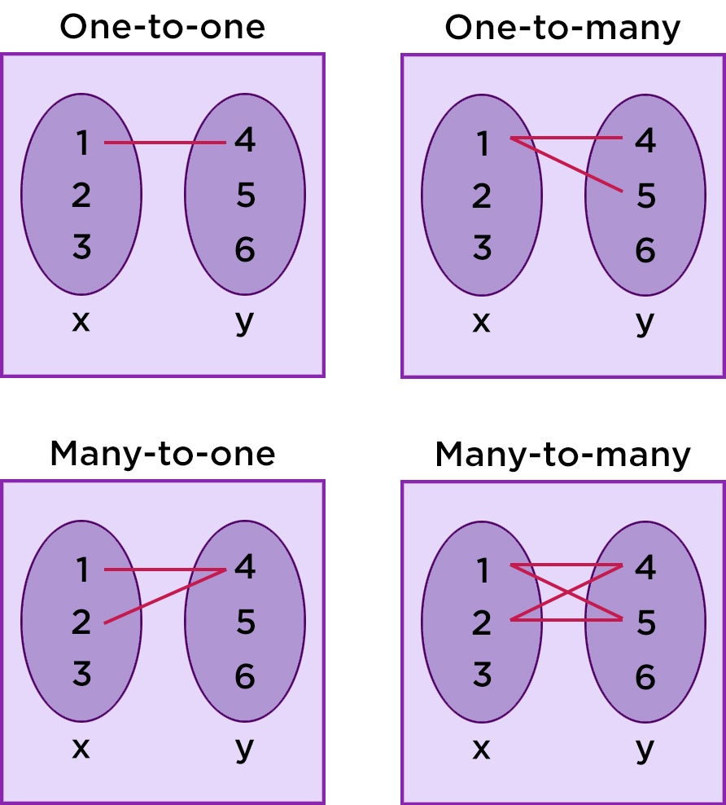
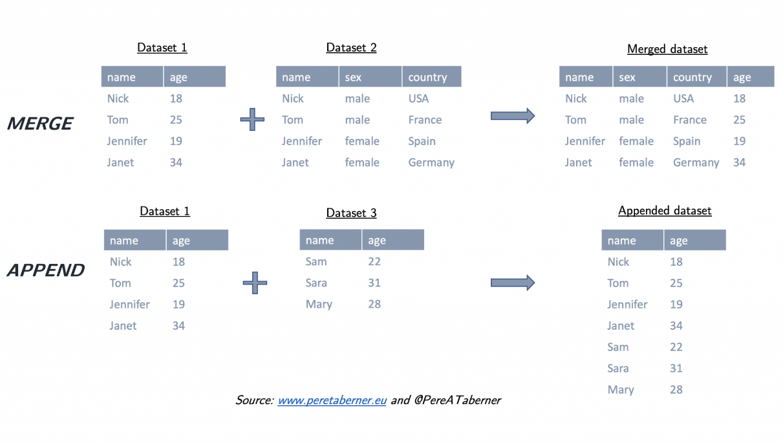
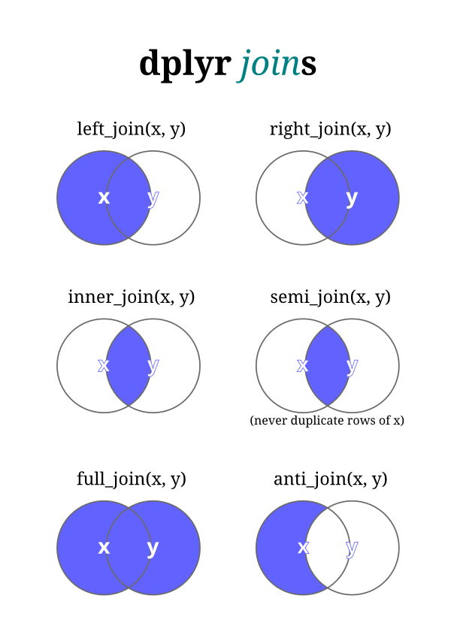
Merge & Append Datasets
Merge and Append are methods to combine scattered data; merge is to combine data horizontally whereas Append is to combine vertically
Logics of joining datasets
Ex: Data Individu + Identifier lokasi

Slide 13
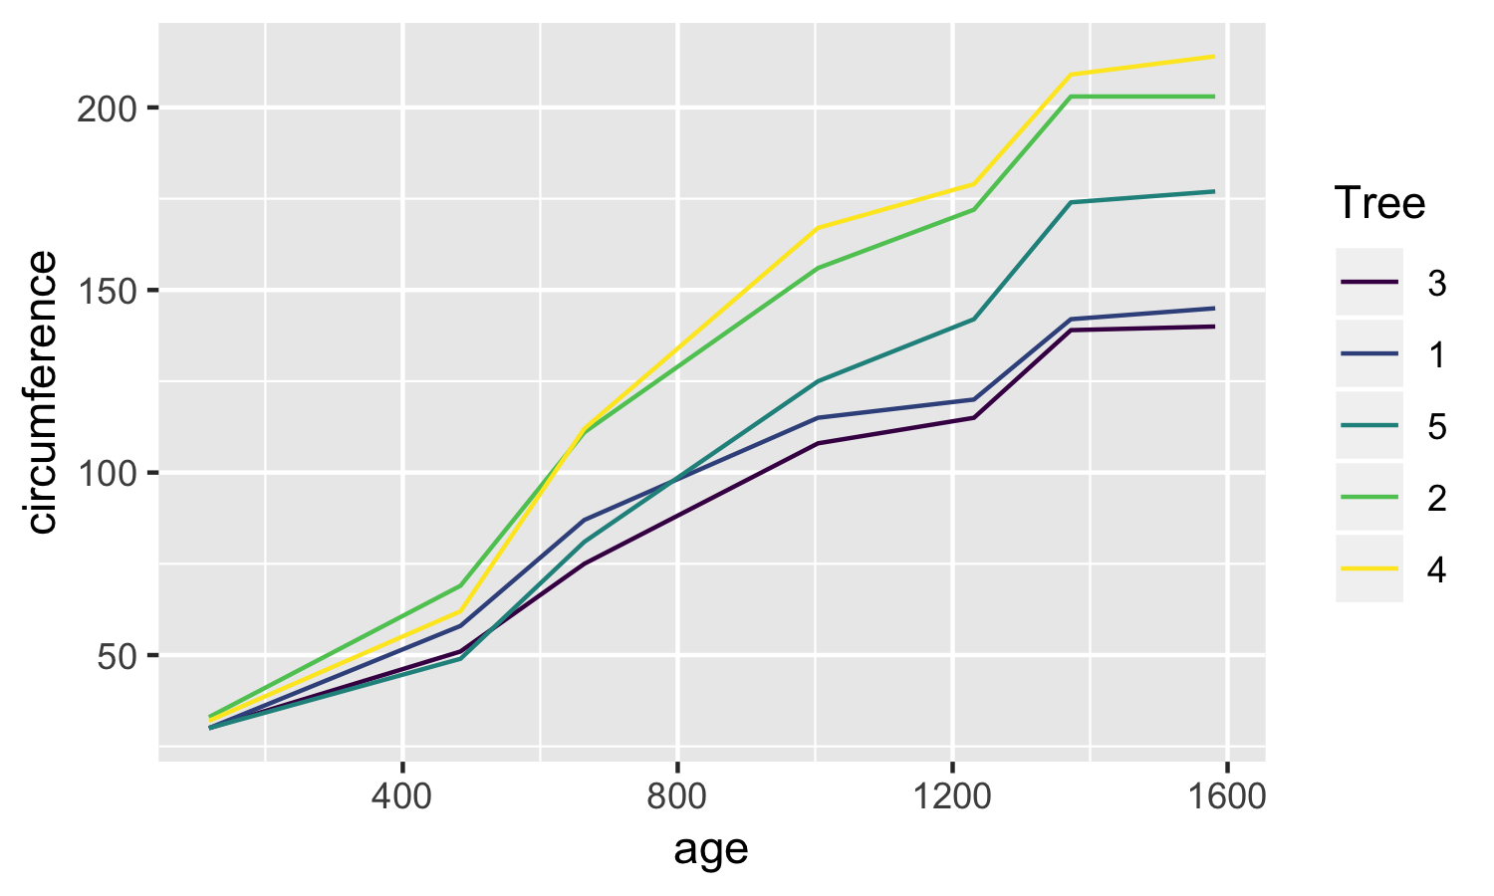
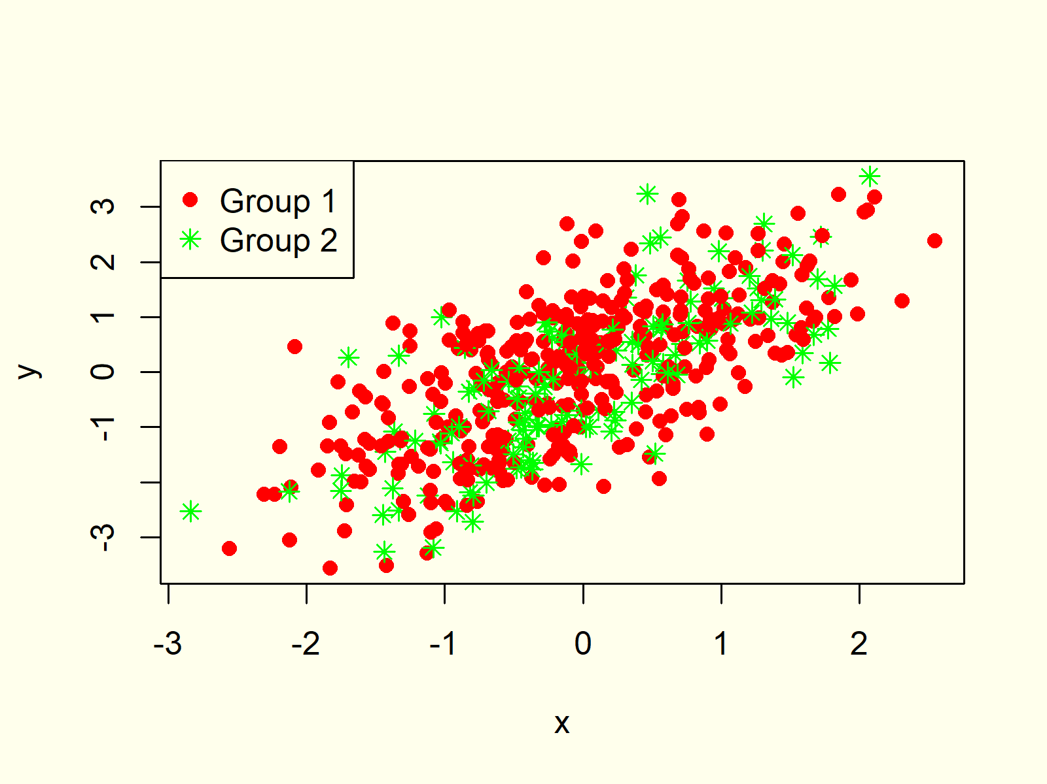
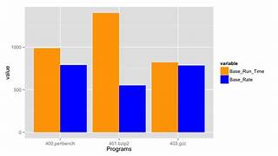
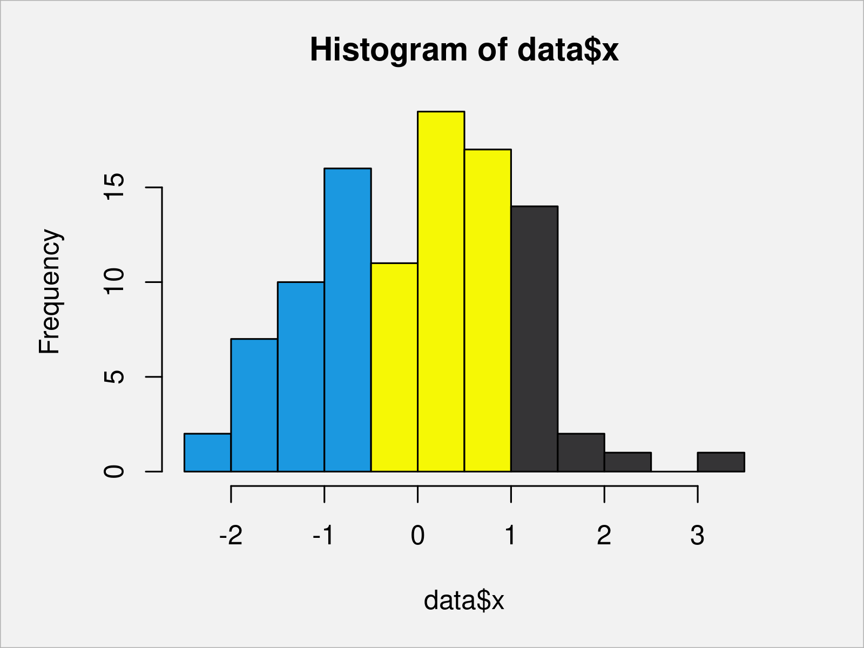
Data Viz
Data visualization is the graphical representation of information and data. By using graphical tools can help us to see and understand trends, outliers, and patterns in data.
Some examples:
Line chart: a graph that connects a series of points by drawing line segments between them
Scatter plots: show many points plotted in the Cartesian plane
Histogram: represents the frequencies of values of a variable bucketed into ranges.
Bar chart: represents data in rectangular bars with length of the bar proportional to the value of the variable

Slide 14
Operasi Sederhana

Slide 15
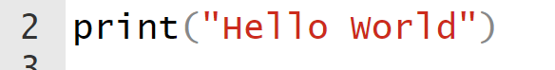
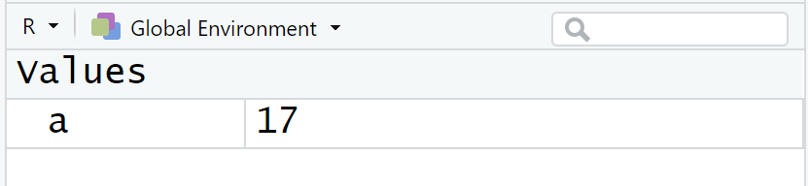
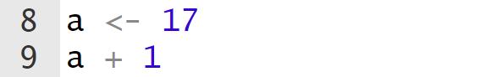
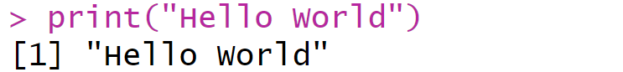
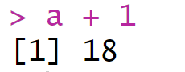
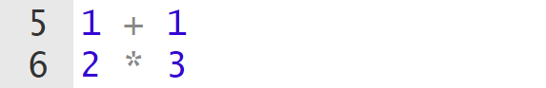
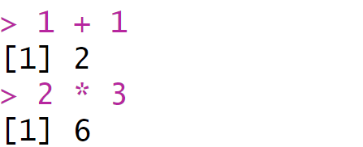
Simple Operations

Slide 16
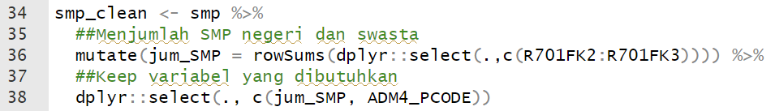
Pipe operator “%>%”
Pipe in R is an operator that takes the output of one function and passes it into another function as an argument. It links together all the steps in data analysis making the code more efficient and readable.
You can type 3 steps of data wrangling cleaner, shorter, and only in 1 code line

Slide 17
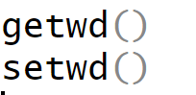
Folder Management and Importing Files
The working directory is the location where R will look for files you want to load and where it will put any files you save.
To import files, we can use different functions depending on your file type
To check your current directory
Ex:
read.xlsx from library(openxlsx) to import .xlsx file
read.csv from base R to import .csv file
read_dta from library(haven) to import .dta file
st_read from library(sf) to import .shp file
You can set your preferred directory using setwd
In R, you have to change your directory path from “\” to “/”
Your imported data is then stored in global env named “dat1”
Tips!
Always put all necessary files for your project in a folder (you can create some subfolders inside it)
Tips!
You can store folders’ paths in global env that will ease your work when using multiple folders
This function is useful for pasting words

Slide 18
Statistika Sederhana

Slide 19
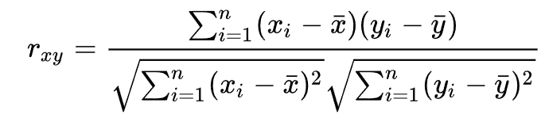
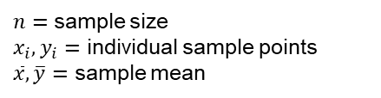
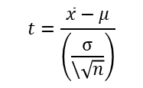
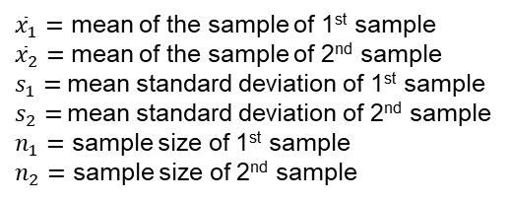
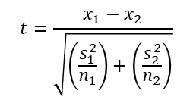
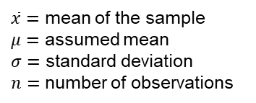
Inferential Statistics
One sample t-test
Two sample t-test
$$t=\frac{\overline{x}−μ}{\left(\frac{σ}{\backslash \sqrt{n}}\right)}$$
$\overline{x}=$ mean of the sample
$μ=$ assumed mean
$σ=$ standard deviation
$n=$ number of observations
$$t=\frac{{\overline{x}}_{1}−{\overline{x}}_{2}}{\sqrt{\left(\frac{s_{1}^{2}}{n_{1}}\right)+\left(\frac{s_{2}^{2}}{n_{2}}\right)}}$$
${\overline{x}}_{1}=$ mean of the sample of 1st sample
${\overline{x}}_{2}=$ mean of the sample of 2nd sample
$s_{1}=$ mean standard deviation of 1st sample
$s_{2}=$ mean standard deviation of 2nd sample
$n_{1}=$ sample size of 1st sample
$n_{2}=$ sample size of 2nd sample
Pearson Correlation Test
$n=$ sample size
$x_{i},y_{i}=$ individual sample points
$\overline{x},\overline{y}=$ sample mean

Slide 20
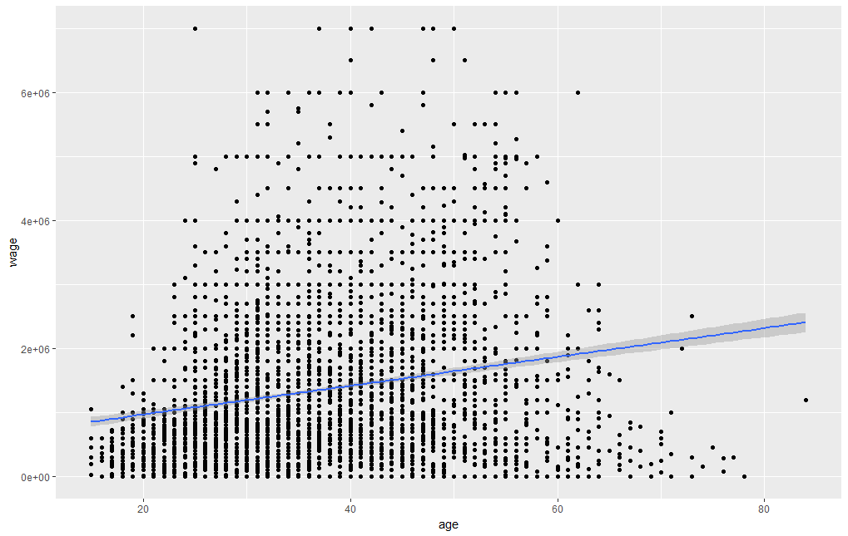
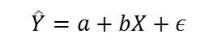
Simple Linear Regression
The method of least squares is a parameter estimation method in regression analysis based on minimizing the sum of the squares of the residuals (a residual being the difference between an observed value and the fitted value provided by a model) made in the results of each individual equation.
$$\hat{Y}=a+bX+ε$$

Slide 21
Thank You

